Slide 1
Building Welcoming Workplaces
Ute Fiedler, MBA, MEd
BTC Consulting

Slide 2
Land acknowledgement
The land we’re on
The land and its history are part of who we are.
We acknowledge that we are in the unceded territory and ancestral homeland of the Mi’kmaq, Maliseet, Passamaquody, Beothuk, Inuit and Innu Peoples.
As facilitators, we strive for collective healing and reconciliation based on friendship and mutual respect.
https://www.whose.land
Notes:
Learn how to pronounce all names properly

Slide 3
Diversity is a fact.
Diversity is a fact. Equity is a choice. Inclusion is an action. Belonging is an outcome.
– Arthur Chan
Notes:
(roll call – ask a person to talk about Diversity, equity, inclusion belonging…. Connect to what they are saying and the info below)
Diversity is a fact. What is diversity? Do you agree with that? Why?…. Mention statistics re: immigration to Atlantic Canada
Equity….
Canada is recognized globally for its approach to and support of diversity. It has developed a broad and evolving legislative and policy framework that supports various elements of diversity and inclusion, including:
• Canadian Human Rights Act
• Employment Equity Act
• Canadian Multiculturalism Act
• Official Languages Act
• Anti-Racism Act
Equality is treating everybody the same – Equity is treating everybody the way they want to be treated to have equal access to opportunity. This course stresses equity.
Inclusion:
spur innovation
increase productivity
create a healthy, respectful workplace
Source: https://www.canada.ca/en/treasury-board-secretariat/corporate/reports/building-diverse-inclusive-public-service-final-report-joint-union-management-task-force-diversity-inclusion.html
Inclusion… How does that work? It starts with you and with developing an intercultural perspective.
Belonging… if newcomer employees develop a sense of belonging with your company, they will stay and tell their friends.
If newcomer employees don’t feel they belong, they will leave and still tell their friends.
Share a story of a company who developed a strong relationship with their newcomer employees.
Oxford Frozen Foods group employees by ethnic origin, so they can speak their native language. They also have a strong connection with the local school to help with settlement services for newcomer families.
A subway restaurant owner saw great potential in a newcomer employee and promoted him to become his right hand. The relationship extended to the entire family and the owner was asked to become the godfather to one of the newcomer’s children.
When you treat people the way they want to be treated as opposed to the way you want to be treated, you include diversity. The outcome is great for business. Less turnover, more loyalty, and a good reputation in the immigrant community.

Slide 4
Who are you?
Introduce yourself in the chat.
For example: your title, company, how much experience you have with newcomer employees
Notes:
Start interacting from the start. If you’ve had problems engaging people in your sessions in the past, interaction may be key to fixing that. It helps pull in your participants and sets the stage for an interactive and engaging workshop.

Slide 5
What do you hear right now?
Tell us in the chat.
Notes:
What do you hear right now? For example, I hear my water kettle boiling. Please share what you hear in the chat.
You’re trying to help them identify the distractions around them.

Slide 6
What else could you be doing right now?
Tell us in the chat.
Notes:
What else could you be doing right now? For example, I could be checking my emails or write a report. What could you be doing?
You’re trying to help them identify the distractions inside their heads. ☺

Slide 7
Learning online is tricky!
Be present!
Put your phone aside. Really. Do it.
Tell people around you that you’ll be busy for a few hours.
Be prepared!
Get a snack and something to drink. Grab a pen and a piece of paper.
Centre yourself.
Notes:
Let me know in the chat when you are ready!
Help them develop strategies for learning successfully online.

Slide 8
Why learn about intercultural competency?
Better communication with employees, suppliers, partners and customers.
More effective and empathetic management
More effective hiring practices
A more inclusive and innovative workplace
Notes:
Objective: Give participants a few reasons and draw the connection to “it’s good for employee satisfaction 🡪 retention 🡪 productivity 🡪 bottom line.

Slide 12
Our learning outcomes
Explain culture and the effects of values and beliefs on behaviour and decision-making in their workplace.
Apply their understanding of culture to the experience of the newcomer in their workplace.
Explore strategies to reduce barriers and improve the sense of belonging for newcomer employees.
Notes:
Also, as we work today, please feel free to ask and add your questions.
Encourage participants to add their own goals. If they suggest something you’re not prepared to talk about because it may be too large a topic or because it’s not part of the learning goals, let them know that while that may not be part of the workshop today, it may be something to consider for future workshops.
Objective: Manage expectations. Some employers may be interested in the technicalities of the AIP program and its processes; however, this course is about developing skills for inclusive leadership and how to build welcoming workplaces for the above-mentioned reasons.
Some employers will want to learn about how to deal with employees’ racism towards newcomer employees. Unfortunately, this is an introductory course to intercultural competency training. Anti-racist training is very value, especially training how to be an ally. Unfortunately, that is beyond what is possible in our 3.5 hours together.

Slide 13
Explain culture and the effects of values and beliefs on behaviour and decision-making in their workplace.

Slide 14
Try this: Cross your arms
Notes:
Objective: This exercise highlights how our brain makes us react quickly and instinctively to different situations. When we want to change, we must slow down our thinking. That takes time and effort. The same applies to intercultural competency skills development.
Please stand up and fold your arms. It would be lovely to see you. So, please turn on your video if you have not already done so.
Facilitator does the same.

Slide 15
Cross them the opposite way
Notes:
Now, relax your arms and fold them the other way.
Wait a few moments. Comment on people looking down on their arms – going back and forth from the intuitive way of crossing their arms to the new way of crossing their arms.
Smile at participants and create a sense that we are all challenged with that.

Slide 16
What did that feel like for you?
Write one or two words in the chat.
Notes:
Habits are strong! And so are our cultural habits we have learned when we were growing up. This workshop will nudge you to develop an intercultural perspective, one that goes beyond our own cultural behaviour which is like crossing our arms… automatic, instinctual.
Our habits are strong as are our cultural habits, i.e. our “common sense.” When we react quickly (without thinking), we think we know what is right and wrong in our and other’s behaviour based on the cultural values that we have learned and that we share with people and communities around us.
Objective: However, if we want to change behaviour, we must pause and think (thinking slow).
Our behaviour can be inflexible – just like the need to cross our arms a certain way. However, with time and an intentional effort, we can change.

Slide 18
MENTAL BOX
Primary
Secondary
Organizational
Cultural
education
industry
time
gender identity
body language
religion
union affiliation
gender
being or doing
marital status
role in company
ethnicity
competition or cooperation
appearance
location
age
language
tenure
conflict resolution preferences
race
family status
management status
physical ability
personal space
communication
style
work experience
individual or team
mental ability
working style
network
views on authority and power
Adapted from Diverse Teams at Work, Loden, Gardenschwartz and Rowe, 1994
Notes:
Objective: This slide shows an example of how we are all different and therefore have diverse mental boxes.
Objective: Explain Equality vs Equity.
We are all individually different and belong to many different groups. That complexity is called intersectionality. For example, not all introverts experience the world around them equally. An introvert women will have a different experience as an introvert non-binary person. Or a white Christian man has a different experience as a black Muslim man.
Understanding the complexity of the intersectionality of these diversity dimensions leads to the questions: Do you as an employer want to treat everybody equally (Equality) regardless of the differences, or do you want to provide everybody with the opportunity to be successful? (Equity)
In this workshop, we will have a closer look at understanding cultural differences (point on the part on the slide that talks about cultural differences. You will learn how your upbringing has shaped you, how newcomer employees may be different from you, and what you can work towards an inclusive workplace.

Slide 19
Which words describe you?
Employees should have independence
Indigenous
Red head
Small workplace
Family comes first
I greet people with a hug
Maritimer
University graduate
Cat person
Canadian
I like to eat
It’s important to have a home
Knitter
In my 40s
Human Resource professional
Large organization
Punctuality is important!
Woman
Manage a business
From abroad
Children should obey their parents
Live in PEI, NB, NS, NL
Medium-sized workplace
Own a business

Slide 20
In some ways, we’re the same. Food, shelter, love … these are universal.
Employees should have independence
Indigenous
Red head
Small workplace
Family comes first
I greet people with a hug
Maritimer
University graduate
Cat person
Canadian
I like to eat
It’s important to have a home
Knitter
In my 40s
Human Resource professional
Large organization
Punctuality is important!
Woman
Manage a business
From abroad
Children should obey their parents
Live in PEI, NB, NS, NL
Medium-sized workplace
Own a business

Slide 21
In some ways, we’re different. We have individual differences.
Employees should have independence
Indigenous
Red head
Small workplace
Family comes first
I greet people with a hug
Maritimer
University graduate
Cat person
Canadian
I like to eat
It’s important to have a home
Knitter
In my 40s
Human Resource professional
Large organization
Punctuality is important!
Woman
Manage a business
From abroad
Children should obey their parents
Live in PEI, NB, NS, NL
Medium-sized workplace
Own a business

Slide 22
As members of a cultural group, we share certain values
Employees should have independence
Indigenous
Red head
Small workplace
Family comes first
I greet people with a hug
University graduate
Maritimer
Cat person
Canadian
I like to eat
It’s important to have a home
Knitter
In my 40s
Human Resource professional
Large organization
Punctuality is important!
Woman
Manage a business
From abroad
Children should obey their parents
Live in PEI, NB, NS, NL
Medium-sized workplace
Own a business

Slide 23
Let’s test that Mental Box
There is no right or wrong.

Slide 24
What do you think or feel?
What do you think or feel when someone doesn’t look you in the eyes during the job interview?
Tell us in the chat.

Slide 25
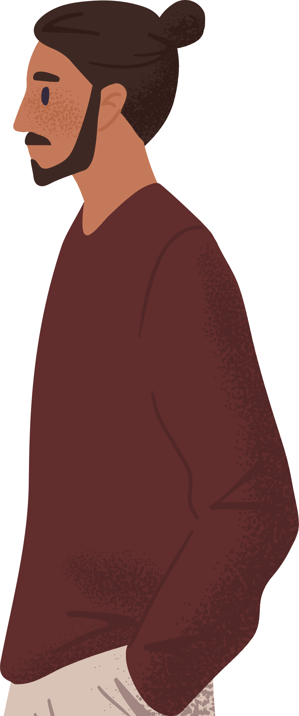
What do you think or feel?
What do you think or feel when someone speaks with a heavy accent?
Tell us in the chat.

Slide 26
What do you think or feel?
What do you think or feel when someone touches your arm when talking to you?
Tell us in the chat.

Slide 27
What do you think or feel?
What do you think or feel when someone is late
for a staff meeting?
Tell us in the chat.

Slide 28
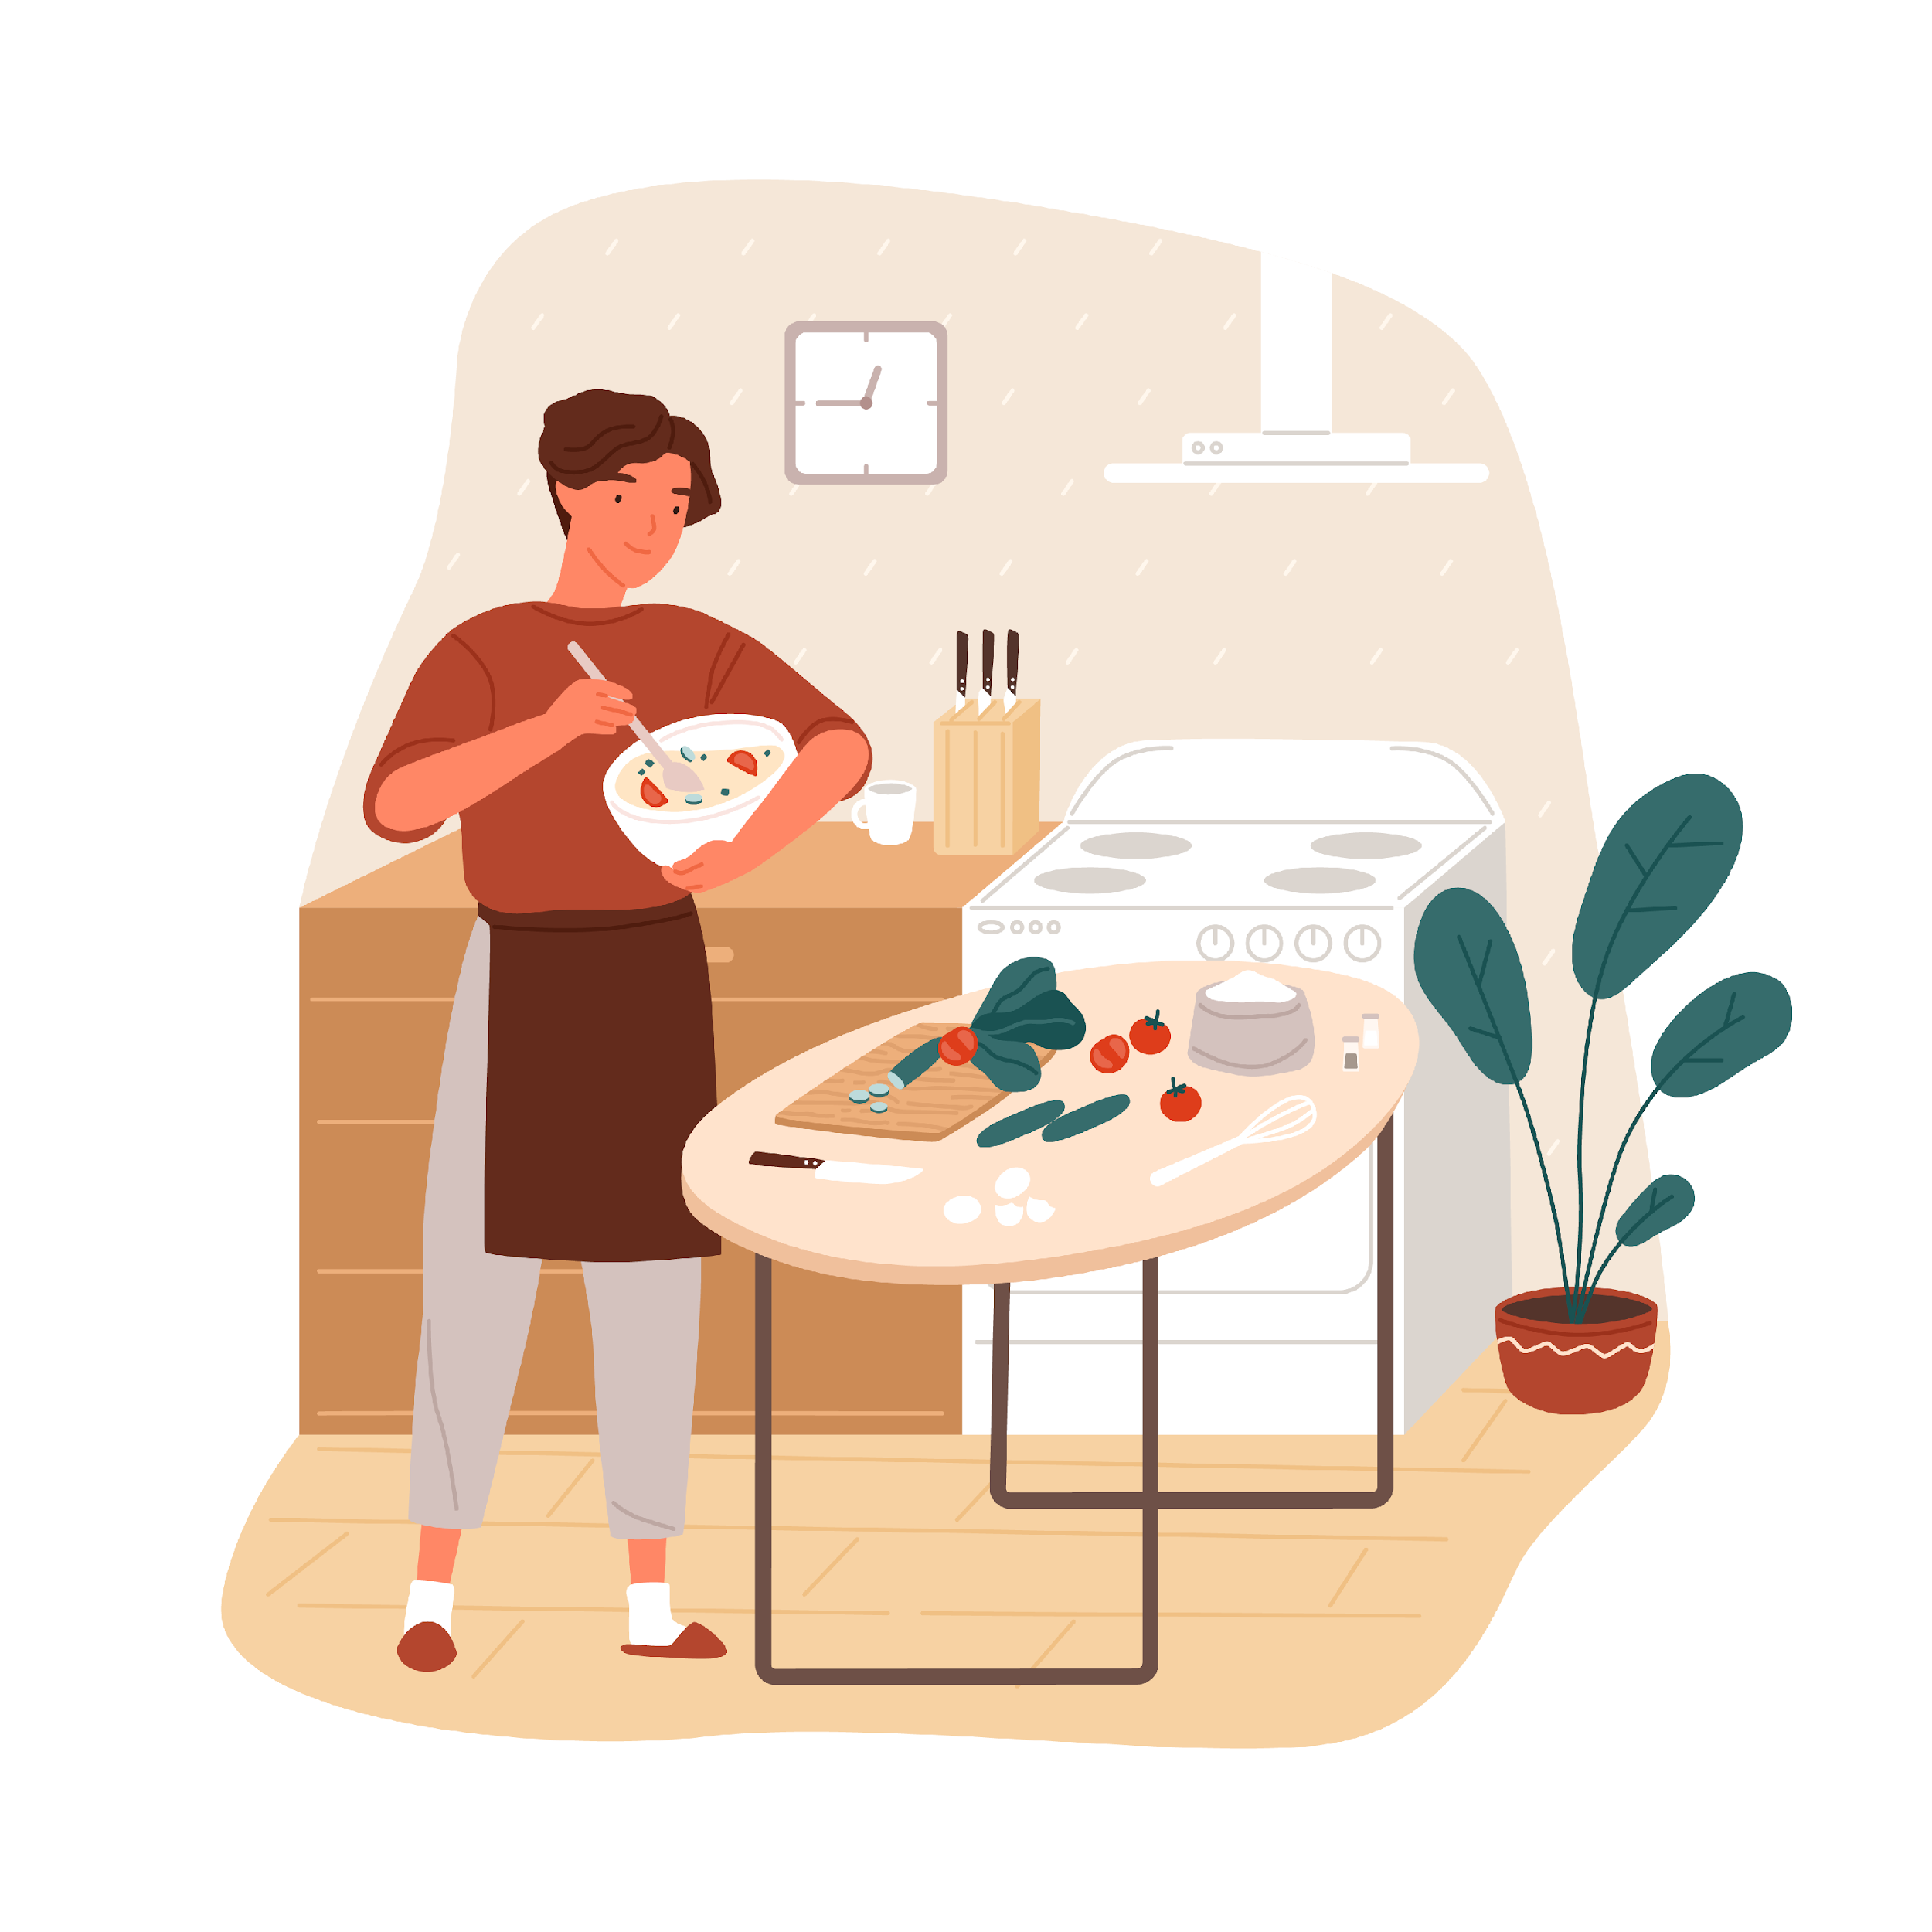
What do you think or feel?
What do you think or feel when a new employee invites you to their home for dinner?
Tell us in the chat.

Slide 29
What is culture?
Tell us in the chat.
Notes:
Objective: Previously, we talked about diversity. Now, we want to focus in on culture. Again, participants have seen culture dimensions on the mental box slide; however, they may not recall. This is an exercise to help them recall and help them identify the distractions inside their heads. ☺
Culture is
Learned
Shared
Unconscious
Dynamic
Emotionally binding

Slide 30
The Cultural Iceberg
What we see
What we assume or take for granted
Notes:
Objective: We want to go deeper into what causes cultural behaviour. The following exercise is a very common one. Participants will re-encounter the cultural iceberg when talking to colleagues or doing further cultural competency training.
The cultural iceberg
This activity helps participants understand that there are parts of culture that we see and parts that we don’t.

Slide 31
What to do
I’ll send you to a breakout room.
Talk with your group:
What differences do we see?
What is hidden?
Pick a spokesperson.
Ask someone to watch the time.
Make a list.
I’ll see you in 10 minutes.
Notes:
Objective: The emphasis of this course is to let participants engage with each other. Peer learning is more effective than the facilitator telling them what is above or below the surface of the iceberg.
You may want to ask if they understand the instructions…
“On a scale from 1-10, how well do you understand what you need to do?”

Slide 32
Breakout Room Activity
Things you see
Things you don’t see
Use your mic or the chat.
Notes:
Objective: During the debrief, capture what participants have come up with.
You can go into edit mode of PowerPoint and start writing down the participants’ contributions during the debrief.

Slide 33
Breakout Room Activity
Things you see
Things you don’t see
Behaviour, dress code, accent, different languages, physical body traits, race, postures/ gestures, music, food, dance, religious dress (e.g. hijab)
Ethnocentrism/attitude, main cultural ideas, stereotypes, religion, beliefs, values, cultural and religious rules, feelings, perceptions, assumptions, our definition of respect
Use your mic or the chat.
Notes:
Share what you heard in the breakout room.

Slide 34
Where do you fit on this line?
Collectivism vs. Individualism
1
2
3
4
5
6
7
8
9
10
Who I am depends
on the group I belong to.
Who I am depends
on my independent accomplishments.
Tell us in the chat.
Notes:
Objective: Demonstrate to participants that there are differences even within one group. You may add your own preference here if it is adding diversity. Have fun with this! Your personal experiences are valuable for the participants.
Individualism: North Americans, tend to value individualism. They believe that initiative and self-assertion result in personal achievement. They believe in individual action and personal responsibility, and they desire a large degree of freedom in their personal lives.
Collectivist: They emphasize membership in organizations, groups, and teams; they encourage acceptance of group values, duties, and decisions. They typically resist independence because it fosters competition and confrontation instead of consensus.
person – tape lines on the floor and identify the extremes on each continuum as a cultural dimension. For example, this continuum is from hierarchical and the other end egalitarian. Give examples of how that looks like in the workplace.
Another continuum is collective vs. individualist and give examples of how that looks like in the workplace.
Participants get a sharpie and draw a line where they think they are on these continua.
Then, reflect on differences and what would cultural misunderstanding look like based on cultural differences clashing.

Slide 35
What happens when these two imaginary people work together?
1
2
3
4
5
6
7
8
9
10
Our accomplishment is based on our group. Together, we decide what to do and success is shared.
My accomplishment is based on my work. Groupwork is challenging, I prefer to split up the work, do my part independently, and combine the individual pieces at the end.
Notes:
Objective: This is to highlight that different perspectives may potentially judge the other orientation towards collectivism or individualism negatively. Intercultural conflict starts when people of different orientations assume that the other “should” think or behave the same way. This course is about building bridges and creating relationships that can bridge these differences without judging.
Collectivism:
Praise and reward group performance.
Don't praise individuals publicly.
Allow people to involve others in decision making.
Individualism:
Praise and reward individual performance.
Give people autonomy to make their own decisions and to use their initiative.
Allow people to be creative and to learn from their mistakes.
Possible conflict based on cultural differences.
Adjustment period is longer
Canadian employer may not recognize an individual’s accomplishments because language from a collectivist member will talk about the group “we” as opposed to “I”. For an individual employer this is difficult to understand and attribute accomplishments to an individual.

Slide 36
Where do you fit on this line?
Egalitarian vs. Hierarchical
1
2
3
4
5
6
7
8
9
10
Give me freedom and the chance to show initiative, so I can determine what best to do.
Give me detailed instructions, so I know what you want me to do.
Tell us in the chat.
Notes:
Hierarchical
Culture accepts inequity and power differences, encourages bureaucracy, and shows high respect for rank and authority.
Egalitarian
Culture encourages organizational structures that are flat and feature decentralized decision-making responsibility, participative style of management, and place emphasis on power distribution.

Slide 37
Delegating
What’s your style?
Get us to this result!
Do it like this to get to this result!
Do this!
Open-ended Delegation
Functional Delegation
Form Delegation
Notes:
Delegation styles depend on cultural values such as egalitarian vs hierarchical.
Egalitarian 🡪 Open-ended Delegation 🡪 employee expects to set outcomes and process methods. Shows initiative.
In between egalitarian and hierarchical 🡪 Functional delegation 🡪 Employee expects clear instruction on expected results and decides on form and process.
Hierarchical 🡪 Form Delegation 🡪 Employees expects clear and detailed instructions on what to achieve and how to get there.
Objective: As managers, there are different styles of delegating. Intercultural conflict occurs when the delegation style of the manager is not aligned with what the employee expects. Awareness is the first step.
What’s your delegation style?
Our culture depends how we behave. Our delegation style is affected by our cultural values.
What is your delegation style?
Good teamwork and leadership in Canada means understanding and working with the cultural values and cultural personalities around you.
Therefore, we need to understand that the way we lead is fundamentally interconnected with the way we delegate, and all that flows directly from how hierarchical or egalitarian the society is.
This means we need to be more focused on what our individual style is and realize that just because we prefer to be led or delegated a certain way, doesn’t mean the other person will be at all aligned.
Therefore, if you’re dealing with someone more hierarchical (either as your boss or your employee) you’ll need to appreciate that they’re used to a much more detailed flow of instructions coming from the boss to the employee, with far less room for the employee to show initiative.
Conversely, dealing with someone more egalitarian means you’ll need to appreciate that generally the boss gives, at best, end goals, and there’s a fundamental expectation for the employee to use initiative, problem-solving etc.
If that difference isn’t a fit for the current situation, then you’re going to have to decide if you’re going to either change the way things are done or keep it the same and specifically train the individual to work differently.
Summary
As with all cross-cultural dealings, know your style, and understand what’s driving the other styles and clearly communicate the two. Where possible, delegate in the method that works for them.
Source: From NBMC Presenters Manual, p. 53: (permission granted on November 17, 2021 by Justin Ryan via email)

Slide 38
Where do you fit on this line?
Orientation towards Time
1
2
3
4
5
6
7
8
9
10
Flexible approach to work.
Punctuality not that important.
Time is fluid.
One task at a time.
Deadlines are important.
Time is money.
Tell us in the chat.
Notes:
Time is Money
People like events to happen in order. They place a high value on punctuality, planning (and sticking to your plans), and staying on schedule. In this culture, "time is money," and people don't appreciate it when their schedule is thrown off.
Focus on one activity or project at a time.
Be punctual.
Keep to deadlines.
Set clear deadlines.
Time is fluid
People see the past, present, and future as interwoven periods. They often work on several projects at once, and view plans and commitments as flexible.
Be flexible in how you approach work.
Allow people to be flexible on tasks and projects, where possible.
Highlight the importance of punctuality and deadlines if these are key to meeting objectives.

Slide 39
Where do you fit on this line?
Personal Space
1
2
3
4
5
6
7
8
9
10
When I talk to people, I need
to feel a connection by touching
their arm or standing close.
I need people to respect
my personal space.
Tell us in the chat.
Notes:
Objective: People have felt the difference in need for personal space. This is just to raise awareness.

Slide 40
Where do you fit on this line?
Communication Style
1
2
3
4
5
6
7
8
9
10
I prefer to be direct in my communication. It’s important to express clearly and precisely what you mean.
I prefer to be indirect in my communication. Harmony with my co-workers is the most important. I will express my disagreement with non-verbal cues to not confront the other.
Tell us in the chat.
Notes:
Objective: People have different communication styles.

Slide 41
There are lots of ways how people are different
Hierarchical
Collectivism
Time is Fluid
Little personal space
Indirect communication
Egalitarian
Individualist
Time is Money
Ample personal space
Direct communication
Notes:
Objective: Summary of cultural value dimensions. You can mention that there are many more, but this is a good start.
You can add your favorite cultural dimensions as you see them fit.

Slide 42
How does that affect my work?
Notes:
Objective: This is an opportunity to apply the heightened awareness of cultural differences to the workplace.
When your participants come up with their typical conflict situations, make note of them for later in the course. Don’t feel pressure to resolve the conflict for them.
This course is providing perspective. It does not provide recipes for how to resolve or avoid intercultural conflict.
Cultural values determine
How employees relate to you
Level of detail in instructions
Direct vs. indirect feedback
How employees relate to their co-workers
Resolve conflict
Teamwork
How you lead
your attitude towards differences
your mentorship

Slide 43
How do we change?
ADAPTATION
We bridge differences
DENIAL
We don’t see difference
ACCEPTANCE
We understand difference deeply
POLARIZATION
We judge difference
MINIMIZATION
We don’t value difference
Adapted from the Developmental Model of Intercultural Sensitivity, M. Bennett, 1986
Notes:
Objective: Raise awareness of developing attitudes towards cultural differences.
Denial to Minimization: I treat people like I want to be treated! – I am more fearful than curious about cultural differences.
Acceptance and Adaptation: I treat people like they want to be treated! – I am more curious than fearful of cultural differences.
Denial (ethnocentric perspective)
Yes, people are different the same way my neighbour is different from me. For example, there are extroverts and introverts and that's no different when we deal with newcomer employees. As long as we speak the same language, we will figure out how to best work together.
Polarization (ethnocentric perspective)
There is just one way of doing business, and we all want the same thing, i.e. be successful at what we do. In polarization, we have learned that there is something different about people coming from India, The Philippines, African countries, or China. At times, some of the newcomer employees are very needy when it comes to giving instructions. They ask a lot of questions. Also, people tend to want to stick around each other and speak their language. It’s disruptive to working in a team; however, I guess there are some differences between us and them, and we just have to teach them how to do business here in Canada.
Minimization (transition from ethnocentric to intercultural perspective)
There are differences among all of us, but as long as we stick to our common goal, we will be able to build on our similarities. We want the same things such as a meaningful job, doing well at work, and getting tasks done. After all, we are all humans, but we all must follow the rules.
Acceptance (Intercultural Perspective in the making)
I have learned through training and experience that managing people from different cultural backgrounds comes with challenges. These challenges may originate from cultural differences. I know that we are similar in many ways; however, I have become curious about exploring cultural differences. In particular, I am curious to learn how these different ways to work and interact with others add new perspectives. I don't feel threatened by the differences; however, I need assistance in making sense of them.
Adaptation (Intercultural Perspective)
I'm embracing cultural differences to include and engage people of different values and perspectives because it is an essential ingredient to my individual and my business’ success. I've learned basic understanding of how cultural differences cause different types of behaviour. Thanks to training, coaching, and exchanging ideas with other businesses dedicated to creating a welcoming workplace environment, I am adopting strategies to allow newcomer employees to bring their full self to work. My business is built on the benefits of bringing multiple perspectives together.

Slide 44
Myth Busters
Notes:
Objective: Ask employers to put themselves in their employees’ shoes. What would they tell their employees when they heard these statements. Your participants are leaders within their company. You are providing them with new perspectives.
“Let’s do a quick Myths Buster Quiz!”
Read out the myths or design an online quiz!
Ask participants what they would tell their employees!
Myths Busting – Could be used for “Thinking out loud” activities
Myth: immigrants take jobs away
Fact: Immigrant secure and create jobs in Atlantic Canada)
Myth: language barriers are a reflecting of lack of technical skills
Fact: Language challenges mean the person speaks other language(s) and has experiences that will potentially add to the workplace culture
Myth: When newcomers speak to another newcomer in their native language they speak badly about the Canadian colleagues
Fact: Newcomers crave speaking in their own language just to relax their brains and indulge in the feeling of belonging. Topics usually cover personal stories, food, cultural events etc. There is no need to take this exclusion personally. Recognize that speaking in one’s native language feels relaxing and makes newcomers feel more at ease. This is good for the team!
Myth: When newcomers arrive late for a meeting, they demonstrate that they disrespect their colleagues/
Fact: Newcomers have a wide variety of different attitudes towards time. Some think that time is money and will be on time to demonstrate respect, others will value relationships to colleagues and family more than the stress of being on time. However, that is not a conscious decision to disrespect others rather an unconscious behaviour based on the cultural values and beliefs that they grew up with.
Myth: As AIP employers we do so much admin work and now intercultural learning. It’s loop-sided!
Fact: Employers need to know that similar support systems are available for newcomers re: learning about Canadian workplace culture.
We will develop more!

Slide 45
Immigrants take jobs away
?
MYTH
REALITY
Tell us in the chat.

Slide 46
Immigrants take jobs away
Immigrant secure and create jobs in Atlantic Canada
MYTH

Slide 47
Language barriers show a lack of technical skills
?
MYTH
REALITY
Tell us in the chat.

Slide 48
Language barriers show a lack of technical skills
These other language(s) and experiences will potentially add to the workplace culture
MYTH

Slide 49
Newcomers speak negatively about Canadians to each other in their native language
?
MYTH
REALITY
Tell us in the chat.

Slide 50
Newcomers speak negatively about Canadians to each other in their native language
Newcomers crave speaking in their own language to relax and feel more at ease
MYTH
Notes:
Newcomers crave speaking in their own language just to relax their brains and indulge in the feeling of belonging. Topics usually cover personal stories, food, cultural events etc. There is no need to take this exclusion personally. Recognize that speaking in one’s native language feels relaxing and makes newcomers feel more at ease. This is good for the team!

Slide 51
As AIP employers, we do so much admin work and now intercultural learning. It’s lopsided!
?
MYTH
REALITY
Tell us in the chat.

Slide 52
As AIP employers, we do so much admin work and now intercultural learning. It’s lopsided!
Similar support and training is provided to newcomers, such as learning about Canadian workplace culture
MYTH

Slide 53
When a newcomer employee arrives late for a meeting, they are disrespecting their colleagues.
?
MYTH
REALITY
Tell us in the chat.

Slide 54
When a newcomer employee arrives late for a meeting, they are disrespecting their colleagues.
Wide variety of different
attitudes towards time
Not a conscious decision but based on cultural values and beliefs
MYTH
Notes:
Newcomers have a wide variety of different attitudes towards time. Some think that time is money and will be on time to demonstrate respect, others will value relationships to colleagues and family more than the stress of being on time. However, that is not a conscious decision to disrespect others rather an unconscious behaviour based on the cultural values and beliefs that they grew up with.

Slide 55
Question
Answer
REALITY
Notes:
Feel free to use this template to create your own question with a “reality” answer.

Slide 56
Apply your understanding of culture to the experience of the newcomer in your workplace.

Slide 57
Have you ever been excluded?
How did that feel?
Notes:
Objective: To apply the newly developed awareness, it is impactful to make participants feel how exclusion feels like.
You can refer back to that later. No one wants to feel excluded.
Give an example of hearing about a friend’s wedding and you were not invited.
Maybe you were not picked for your school’s basketball team.

Slide 58
The Newcomer Journey
The first year
Prepare
Arrive
Integrate
Stay
Notes:
Objective: This is an exercise in empathy. We want to highlight the amount of work that is required by preparing, moving, and integrating into a new culture. Also, you can highlight that depending on newcomers’’ experience, they will decide to stay or leave for a bigger city.
You can also emphasize that employees spend a lot of time at work. Therefore, the experience at their workplace has a significant impact on their final decision to stay or move on.
You can use your own newcomer stories here or tell a story.
Newcomer Journey
Preparation
Visa / Application,
getting family ready, learning English
Immediate
Housing, furniture, utilities, school registration, getting oriented at work, making new contacts
Integration
Connect with community,
building
relationships
Retention
Evaluating the experience: good employer 🡪 tell the community 🡪 more potential employees

Slide 59
The Newcomer Journey
Culture Shock
Honeymoon
Culture shock
Adjustment
Adaptation
Notes:
Objective: In addition to the work that comes with the settlement process, this slide highlights the emotional adaptation process called “Culture Shock.” The following slides highlight the complexity of the newcomer journey.
This information will lead to you promoting your SPO settlement services. Your goal is to create a need from the AIP employers to want to work with you.
The Phases of Culture Shock
Honeymoon Phase
Everything is new and exciting.
Finally arrived!
Culture Shock
Frustrated, misunderstood, disoriented, feeling cultural differences.
Small challenges = Big problems.
No sense of belonging.
Adjustment
lots of learning how work and relationships are, hopeful again. Join team activities. Develop a new routine.
Adaptation
Feeling comfortable,
feeling sense of belonging, cultural differences don’t come as a surprise anymore. Build meaningful connections. Confident again.

Slide 60
The Newcomer Journey
Culture Shock
Honeymoon
Culture shock
Adjustment
Adaptation
employee

Slide 61
The Newcomer Journey
Culture Shock
Honeymoon
Culture shock
Adjustment
Adaptation
employee
spouse

Slide 62
The Newcomer Journey
Culture Shock
Honeymoon
Culture shock
Adjustment
Adaptation
children
employee
spouse
Notes:
Objective: Have employers come up with a list of things newcomers struggle (settlement needs) with in each phase.
The curves represent the culture shock curve. This is the emotional journey of the newcomer. The different curves demonstrate the different emotional journeys family members are on. The person who works adapts at a certain pace. Children may adapt more rapidly; however, there are many conflict scenarios of children being bullied or discriminated in school (wearing hijab, not speaking English/French well, eating food that smell “funny” etc.) With small kids in kindergarten, language issues can cause anxiety in the children with often delayed speech development. In the long-term, child education can be difficult for parents who raise children that behave differently from what they think is appropriate.
Spouses who do not work may experience isolation and a sense of loss.
Hence: Importance of Settlement Services.
Employers come in at different stages in this journey and add to the newcomer experience. Work is an essential need for newcomers. However, the process of obtaining and maintaining work is challenging.

Slide 63
What have you learned about culture shock?
Honeymoon
Culture shock
Adjustment
Adaptation
Tell us in the chat.

Slide 64
What behaviour have you noticed in newcomers?
Tell us in the chat.

Slide 65
What would help newcomers feel like they belong?
Tell us in the chat.

Slide 66
What can you do to help with settlement?
Notes:
Objective: AIP employers have now felt and learned about the complexity of the newcomer journey. Now, we ask them to be leaders and think of one way how they could assist in this process.

Slide 67
What is your company already doing to help with settlement?
Tell us in the chat.

Slide 68
Settlement Plan
Housing / accommodations
Financial
Legal information and services
Health / mental health / well-being
Education / skills development
Family support
Life in Canada
Community and government services
Working in Canada
Education in Canada
Social networks
Professional networks
Level of community involvement
Language skills
Description of settlement plan needs (Source: Canada, IRCC (2020). Evaluation of the Atlantic Immigration Pilot)
Notes:
Objective: Promote your settlement services and the benefits of collaboration between you and the AIP employers.
Your chance to
“If your newcomer employee needs language support, we can help…”
“If your newcomer employee needs help with…”

Slide 69
What supports are available to you and to newcomers?
Notes:
As an AIP designated employer, you are part of a support network for newcomer employees. That means, you are not solely responsible for the settlement needs of newcomers. As we have seen, the SPOs play a critical goal in developing the settlement plan and assist you, the employer, in implementing it. In addition, employers have access to IRCC services through DSC and ACOA.

Slide 70
From exclusion to inclusion
EXCLUSION
SEPARATION
INTEGRATION
INCLUSION
SOURCE: So'Lille - Solidarité Lilloise Etudiante
Notes:
Objective: We felt what exclusion felt like. Now, we want to think positive and describe what the picture on the right feels like.

Slide 71
In an inclusive workplace
We feel validated
We feel valued
We feel included
We are motivated
We are engaged
We are productive
Notes:
Objective: Validate what your participants have said previously
Inclusion has to be intentional.

Slide 72
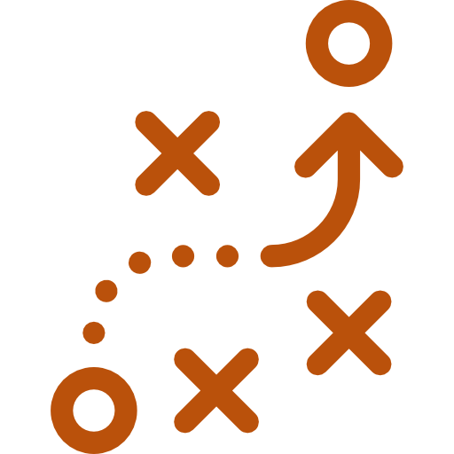
Explore strategies to reduce barriers and improve the sense of belonging for newcomer employees.

Slide 73
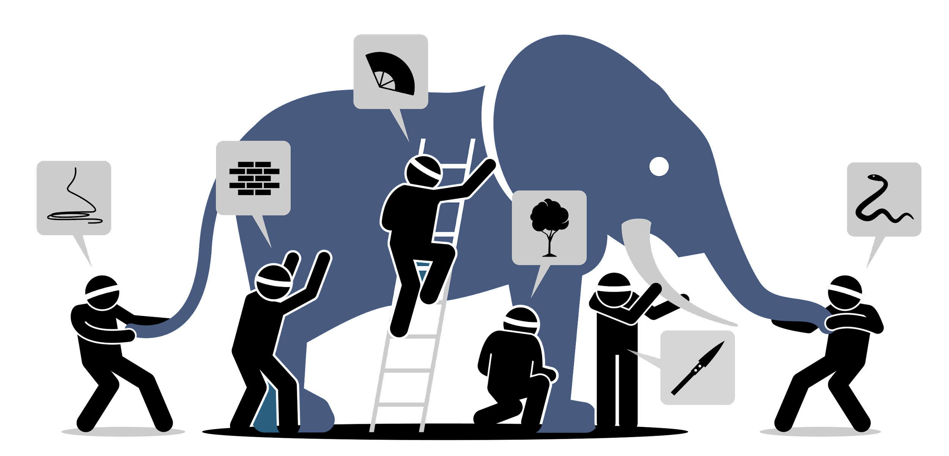
The Blind Men and the Elephant
Notes:
Objective: Storytelling is an effective learning tool. Participants will be able to visualize what is happening.
Once upon a time, there were six blind men who lived in a small village.
One day, a prince from a faraway land rode into the village on the back of an elephant.
Nobody in the village had ever heard of an elephant. What was an elephant?
Each of the men gathered around the prince to try and understand what they couldn’t see.
One man approached the elephant and touched its side. “Ah, this is a wall!” he said.
Another approached the elephant and felt its tusk. “This is round and sharp! It’s clear that this is a spear.”
Another took the elephant’s trunk in its hands and proclaimed “This beast is long and thin. It’s a snake!”
Another felt its knee and said “I’m sure that this is a tree!”
The fifth walked up and touched the elephant’s ear. “This must be a fan!”
And the final blind man walked up and felt the elephant’s tale. “I’m sure that this is a rope.”
They broke into an argument. Each man was sure that they were right. None would listen to any of these others. Each was partly right, but all were wrong.
Based on the poem, “The Blind Men and the Elephant” by John Godfrey Saxe (based on a Hindu parable)

Slide 74
Questions
According to the fable, why do the six men fail to get along?
According to the fable, would the story have been the same if the six men had not been blind?
What do you think of the reaction of the six blind people?
If the elephant had been a person, what would it have said?
What are our prejudices about our newcomer employees?
Notes:
Objective: We want to guide the participants’ critical thinking with these reflection questions. Ultimately, we want the participants to realize that we have prejudices, stereotypes, and biases towards newcomers because we are blind. We cannot see what is below the surface of the cultural iceberg.
In the debrief, validate what everybody is saying and guide them towards the question: Now, we need a tool. What can help us approach complex situations like these?

Slide 75
VABB
AFFIRM
VALIDATE
BRIDGE
BUILD
Notes:
Objective: The previous discussion will provoke the questions “But how can we learn all this?”
VABB is an inclusive approach – transforming cultural conflict situations into relationship building.
VABB is an inclusive approach built on relationships. It helps us move away from our patterned behaviour, break down our prejudices and create bridges between other cultures and our own.

Slide 76
VABB
AFFIRM
Suspend judgement and validate what the other person is saying.
Be positive. Slow down and be aware of your own stereotypes.
VALIDATE
Newcomers can add a different perspective and help you see your business in a new way. Bridge your values and the newcomers’ values and build relationships.
Bring their perspective into your company.
BRIDGE
Build bridges between the values of your company and the newcomers’ values. Teach what you expect from them.
BUILD
An inclusive approach built on relationships

Slide 77
Imagine
Imagine you’ve just hired a newcomer.
They arrive late for your first team meeting.
Using VABB,
what would you do?
Tell us in the chat.

Slide 78
VABB
I take a positive look at my newcomer employee by highlighting their qualities, including the fact they speak several languages.
I reflect on the action of my employee, and I validate the fact their behaviour is cultural, and it is not necessarily inappropriate.
AFFIRM
VALIDATE
BRIDGE
I invite my newcomer employee to lunch to talk about the company's values and standards, including the importance of arriving on time. I build a mentorship relationship.
I incorporate my newcomer employee's perspective and propose to share during one-on-one meetings.
I encourage them to capture ideas and send them to me to bridge differences.
BUILD
An inclusive approach built on relationships

Slide 79
What’s one way you’d use VABB?
AFFIRM
VALIDATE
BRIDGE
BUILD
Tell us in the chat.

Slide 80
Strategies to bridge differences
Ask for clarification
Consultation & collaboration
Know yourself: Be culturally aware
Be explicit
Mentorship: Relationships first
Notes:
Objective: This is to summarize from the previous exercise what AIP employers can do to build relationships with their newcomer employees.
Ask: How might we work better with those who are more collectivist (see themselves as part of a group)?
Or those who are more hierarchical (prefer detailed instructions so they know what to do)?
Be culturally aware – of your own culture and others
If you're making an assumption, ask for clarification
Initiative and independence are individualistic - be more explicit, give often and detailed instructions and feedback
Encourage consultation and collaboration
Focuses on relationships first – newcomer employees need to learn to trust you – therefore 'time is love’
Bridge - This Photo by Unknown Author is licensed under CC BY-SA

Slide 81
What are your strategies to create a more inclusive workplace?
Tell us in the chat.
Notes:
Here are a few:
Organize « lunch and learns » to talk about inclusion, equity and dialogue between cultures.
Display a map showing which countries newcomer employees come from.
Display a calendar showing different celebrations and holidays from different cultures.
Display the different languages spoken by newcomer employees.
Create an inclusion charter.
Display anti-discrimination slogans.

Slide 82
What have you done?
Explained culture and the effects of values and beliefs on your behaviour and decision-making in your workplace.
Applied your understanding of culture to the experience of the newcomer in your workplace.
Explored strategies to reduce barriers and improve the sense of belonging for newcomer employees in your workplace.
Notes:
Based on the highlights of the workshop, summarize the discussions where participants were most engaged.
For activities:
Evaluate your business/workplace?
What are you doing now? What goals do you have to …
Who are your vulnerable employees?
What are the barriers in your workplace?
What changes will you make to reduce or eliminate those barriers to make sure our workplace is inclusive?

Slide 83
Setting goals
With a partner, pick 1-2 goals to help integrate your newcomer employees
Write them down
Notes:
Objective: You want AIP employers to commit to one or two strategies that can potentially change the newcomer employee experience for the better. However, with this course and the proposed inclusion strategies, all diverse employees will benefit regardless of whether they are ethnically different or different in any other way.
At this stage of the course, you want to answer any questions participants may have. Some may be quiet; in which case you want to ask questions and encourage them to engage. Peer learning and learning about what other employers are doing for their newcomer employees is impactful for this training.
Don’t let employers push you into a situation of “And what do I do then?” You are here to facilitate and not to provide recipes. There is no one way of including newcomer employees into the workplace. VABB is one approach to critically think about options and to return to the most important point: relationship building.

Slide 84
Setting goals
Would you like to share yours?
Tell us in the chat.

Slide 85
Write a commitment letter
Notes:
Commitment Letter Sample:
Dear me,
Today, I have participated in a workshop which highlighted the important of the intercultural perspective when managing newcomer employees. As a result, I commit to doing this…”
Signature

Slide 86
One thing I learned today that I can use
Tell us in the chat.

Slide 87
One piece of advice you’d give to new AIP employers?
Tell us in the chat.

Slide 88
Course evaluation
Any questions? Share in the chat.

Slide 89
Thanks!
We’re here to support you.
Add your contact info

Slide 90
Sources
All icons by Freepik are licensed under CC BY 3.0.
Unless otherwise credited, all images are used under license from Shutterstock.
Accessibility
These slides meet Web Content Accessibility Guidelines 2.0 (WCAG).

